Slide 1
Project Based Learning –IV
Lumpy Disease Classifier
Submitted by: Vanshita Kapoor (2110993882)
Faculty Coordinator: Dr. Vandana Sood
:
Chitkara University Institute of Engineering and Technology,
Chitkara University, Punjab

Slide 2
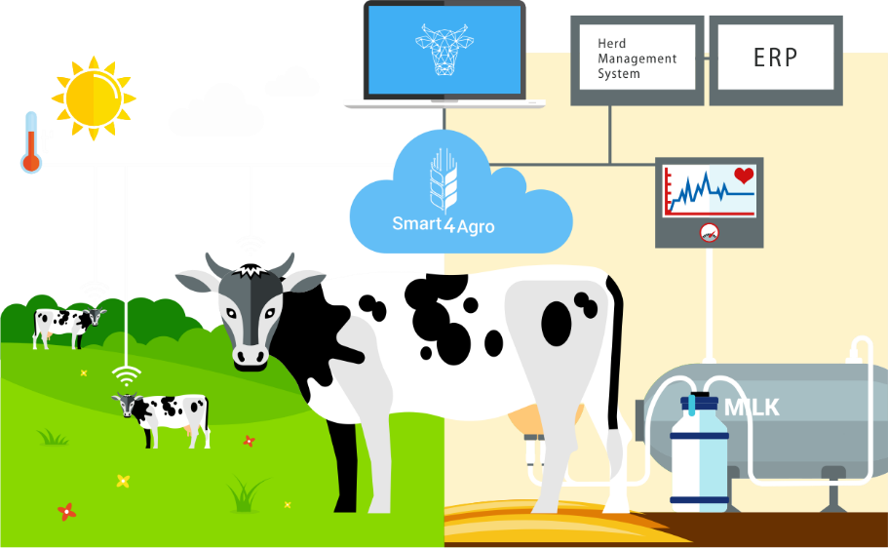

Slide 3
Table of Contents
1.Problem statement
2.Introduction
3.Technology
4.Flow of the project
5.Code of the Project
6.Results
7.Conclusion

Slide 4
Introduction
Disease Classification In Cows Using 2D CNN
Lumpy Diseases Classifier is a novel machine learning-based approach designed to detect and classify various lesion-based medical conditions. Lesions, characterized by abnormal tissue growth or structural changes, are indicative of numerous diseases, ranging from benign to malignant. Accurate identification and classification of these conditions are crucial for timely intervention and effective treatment. The proposed classifier leverages a large dataset of annotated lesion images, allowing the model to learn complex patterns and discriminate between different disease categories.The workflow begins with preprocessing the input images to enhance contrast, reduce noise, and standardize the image properties. Subsequently, a feature extraction step extracts meaningful features from the images using techniques such as convolutional neural networks (CNNs) and image processing algorithm. To evaluate the performance of the Lumpy Diseases Classifier, various metrics are used. The model is trained and tested on a diverse dataset comprising images from different anatomical regions and a wide range of lesion types.

Slide 5
Problem Statement
There are lot of farms where live stocks are maintained poorly and where there is a lack of veterinary experts.
Many a times this happens that Normal farmers could not detect the presence of any disease or virus in cattle, which causes death and the spread of that virus in other animals.
Lumpy skin disease this viral infection has killed nearly 75,000 cattle in India and spread to more than 10 States and UTs, hitting Rajasthan the worst.

Slide 6
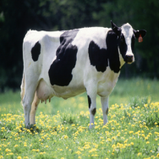
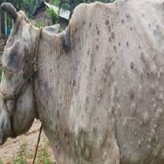
Project Highlights
LUMPY SKIN DISEASE CLASSIFIER
Cattle external diseases like Foot and Mouth Disease (FMD), Lumpy Skin Disease (LSD), and Infectious Bovine Keratoconjunctivitis (IBK) are the most highly contagious diseases around the world.
Early diagnosis is crucial for controlling these diseases. Traditional Convolutional Neural Networks is the most used architecture in the state-of-the-art of image processing and computer vision field. So we have used CNN for training our classification model for Lumpy Skin Disease. The proposed system is established to be effective, acquiring results with 80-90% accuracy, which may reduce human errors in the identification process and will be helpful to recognize diseases for veterinarians and husbandry farmers.

Slide 7
Technology Used
1.Python|Pandas|Numpy|Tensorflow|sklearn
2.Html|CSS|Boostrap
3.Javascript
4.jQuery
5.Flask API
6.CNN

Slide 8
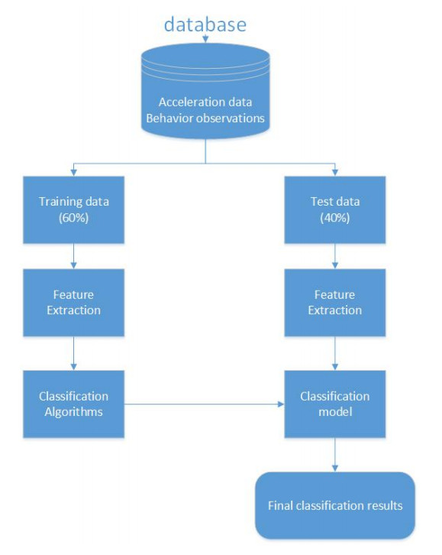

Slide 9
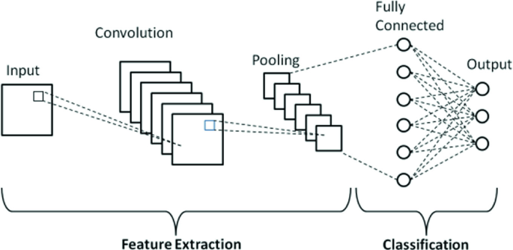
Flow of lumpy disease classifier

Slide 10
HIDDEN
LAYER
INPUT
OUTPUT
HEALTHY COW
LUMPY COW

Slide 11
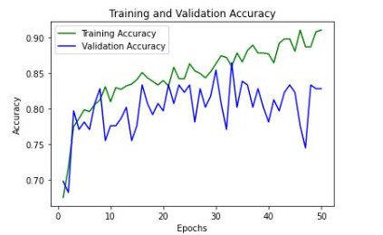
Results
In disease classification model

Slide 12
Results
In lumpy disease classification model, the accuracy
80-90% for
training
75-85% for
validation

Slide 13
Conclusion
This work can be extended by adding more information to the input of the network such as the physical dimensions, environmental conditions, etc. This can help a lot in farms where live stocks are maintained poorly and where there is a lack of veterinary experts.
Diseases can be detected very early and hence necessary steps can be initiated for curing them. In the future, enhancing the network could also be a value attempting to get higher results. To enhance the inputs to the network, one could use sensors integrated with the Internet of Technologies (IOT) to raise alarms in case of an outbreak of symptoms and capture state information which will further strengthen our evidence.
By applying machine learning to sensor data, farm management systems are evolving into real artificial intelligence systems, providing richer recommendations and insights for the subsequent decisions and actions with the ultimate scope of production improvement. For this scope, in the future , it is expected that the usage of ML models will be even more widespread, allowing for the possibility of integrated and applicable tools.

Slide 14


